Slide 1

Honors Project Lexical Analyzer in c
By: Bemnet Merkebu

Slide 2
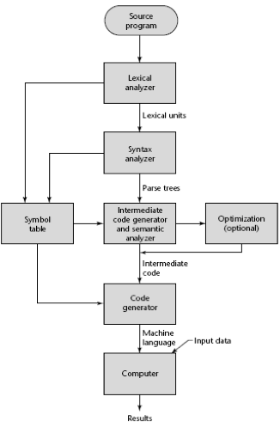
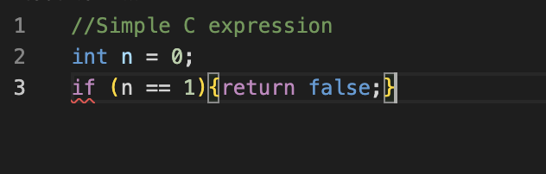
Overview
Compiler: a program that changes a code into a machine-understandable format
Think of it as a translator from your code into the machine
This means reading through each character of the entire file
Consisted of different parts and stages
Let’s evaluate a simple C expression

Slide 3
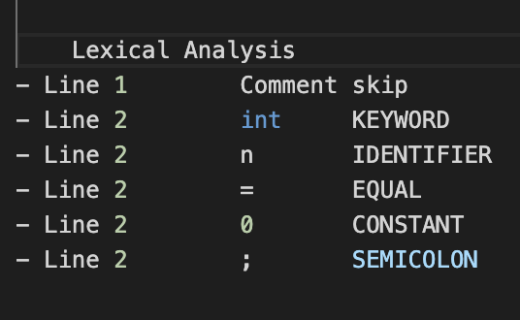
Overview
The main parts of a compiler are lexer and parser
Lexer converts every character or group of characters into specific tokens
Parser analyzes the syntax in which the tokens are ordered
Lexical analysis is the basic process, we can’t be overlapping with parsing syntax

Slide 4
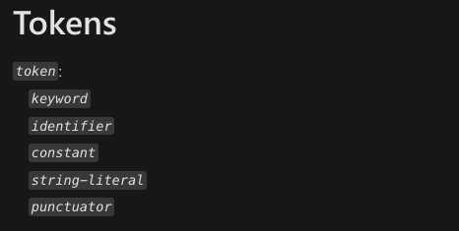
C – lexical grammar
Standard C grammar contains few token types
These token types can further be specified
https://learn.microsoft.com/en-us/cpp/c-language/lexical-grammar?view=msvc-170

Slide 5
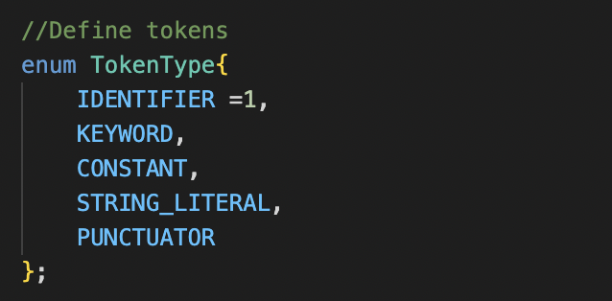
Steps taken
Define the standard C token types
Implement with an enumerated list, (indexed list)

Slide 6
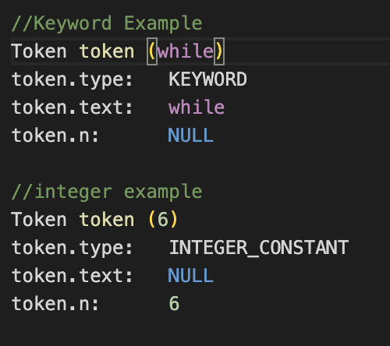
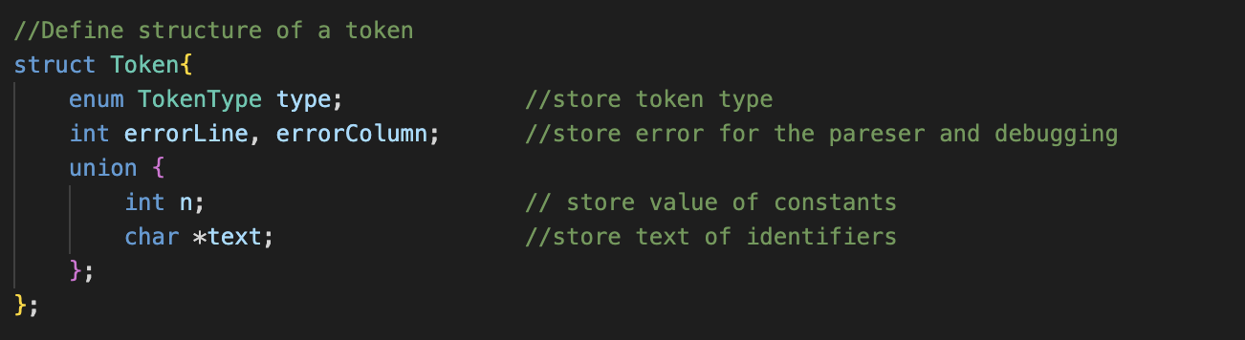
Token structure
Define struct to handle the data of tokens
Value
Int – for numerical values
Char – for labels
Token Type
Error module (For the next part of the compiler)

Slide 7
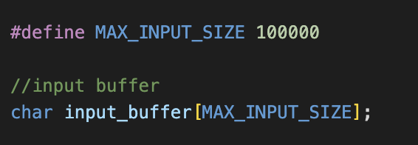
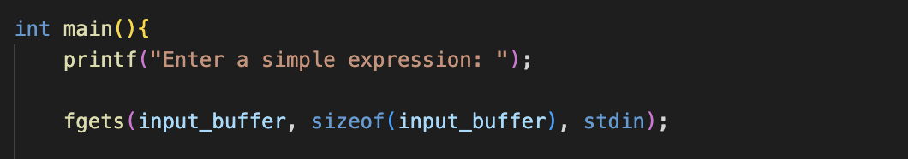
Input buffer
Input buffer
Take the input and store it in intermediary
Helpful for optimal resource use and debugging errors

Slide 8
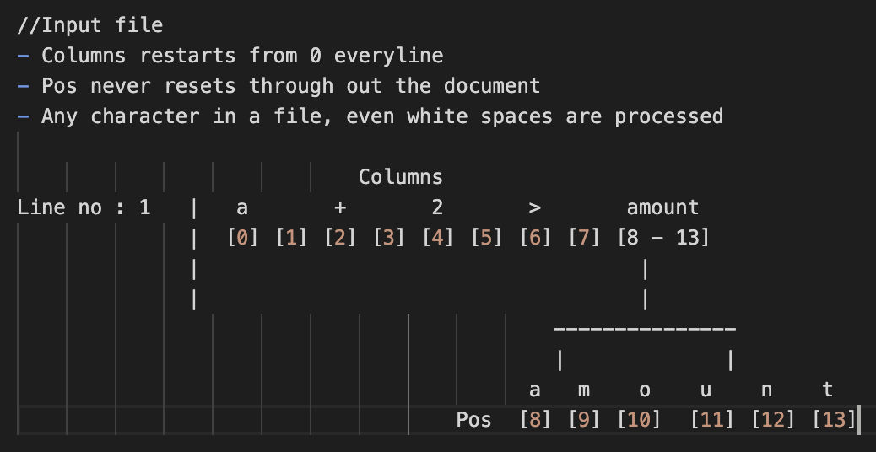
Input processing
Divide the raw code into lines, columns (grammar equivalent for words), characters
Make a next character function that checks whether a newline is detected or which column and position the cursor is at
I didn’t use regex matching rather evaluated each character
Will need a finite state to detect tokens

Slide 9
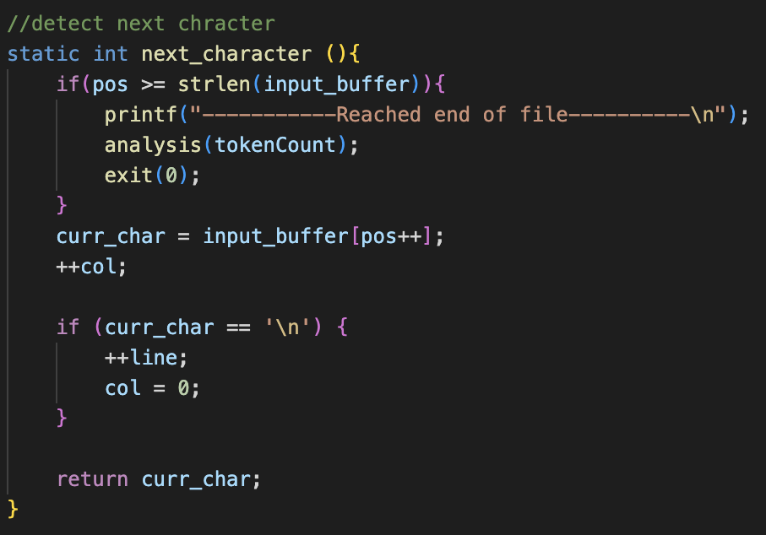
Next character ( )
Iterate through the characters in the buffer
Return the next character to analyze
Check if a new line is detected
Increment Line by 1
Set Column to 0
Check if it is the End of the file
Output final analysis
Terminate the program

Slide 10
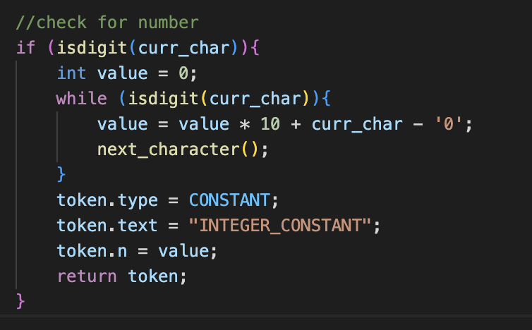
Detect Constants
Use isDigit( ) generic C function
Iterate through the characters in the buffer
Check if the current character is a number
Set token type to CONSTANT
Specify the type of constant
Next character

Slide 11
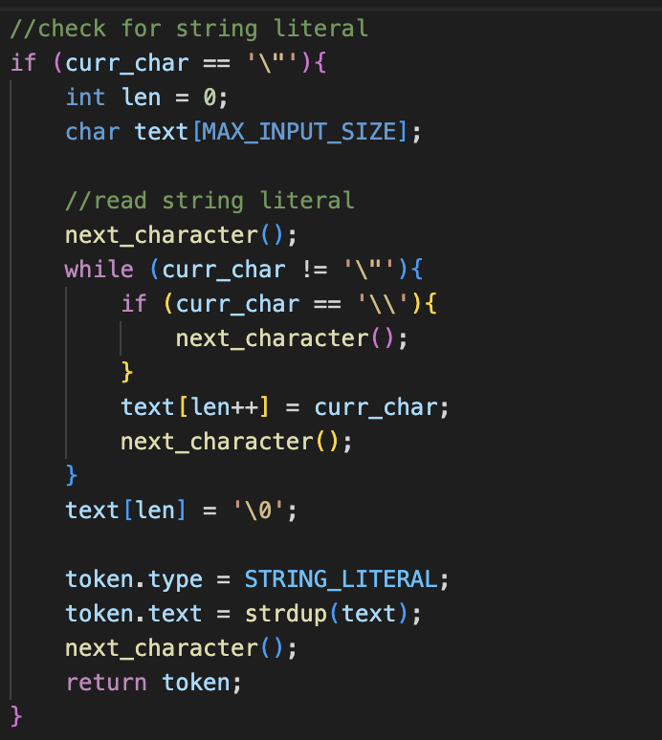
Detect String literals
Detect for an alphabet or num enclosed in “ ”
Create an array of type char to accumulate the following characters
Check if the current character is “
if ” or / is not detected
Keep on adding the characters to the array
else
Set the token type to STRING_LITERAL
Set the description text to the value in the array
Return token

Slide 12
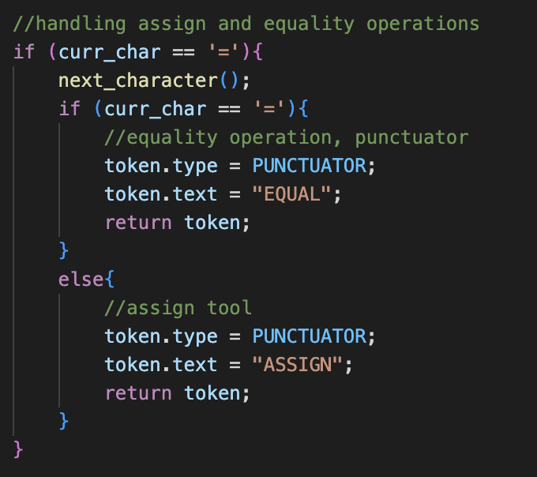
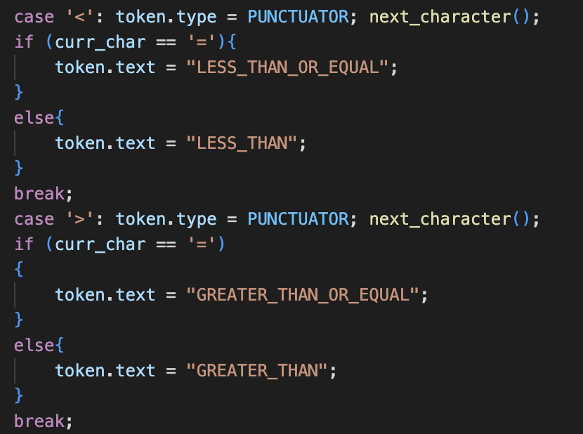
Detect two character tokens
Scan current character
Check if the next meets the condition, then set token type

Slide 13
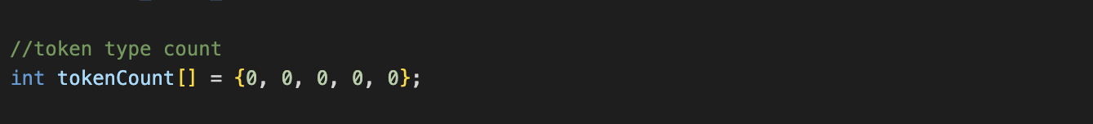
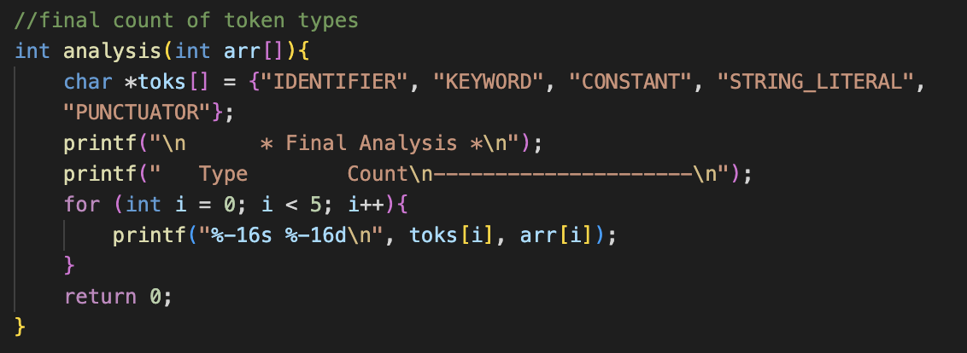
Token count accumulator
Output the count of tokens detected
Create an array of length 5 and type integer
Increment each array element according to the token type
Output the token counts

Slide 14
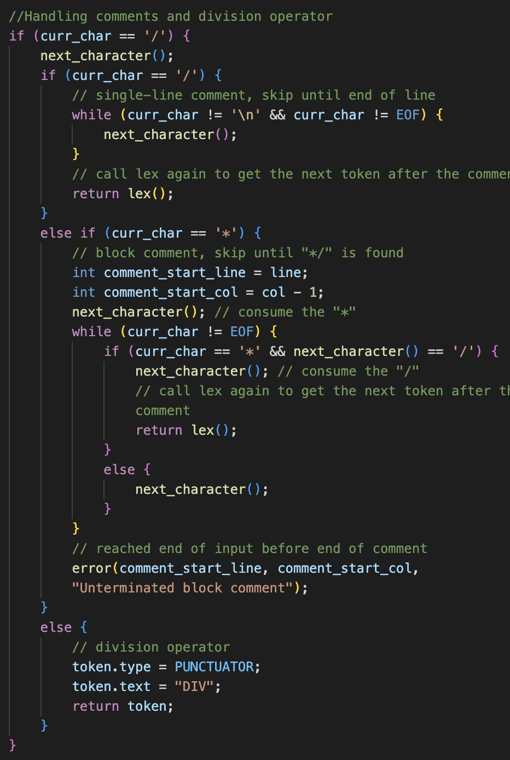
Comment handling
Handle different versions of comments
If a comment is detected, skip characters
Types of comments:-
Inline comments
Skip any stream of characters following ‘//’
But stop End of the line or ‘\n’
Block comments
Skip any stream of characters following ‘/*’ till set of ‘*/’ is detected
Multiple-line comment handling

Slide 15
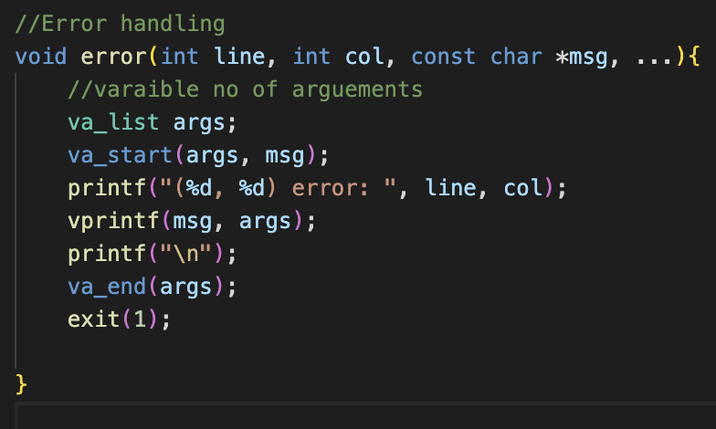
Error handling
Uses line and column of the current character
Takes in the specific error message
Check if the arguments are met
Outputs the error message
Output a new line

Slide 16
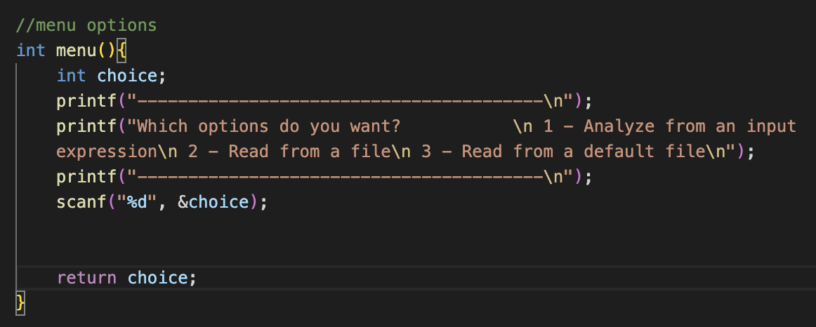
Program Versions
Standard input version
Debugging Version
Run from a default file

Slide 17
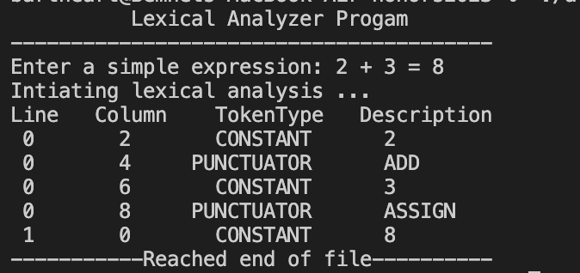
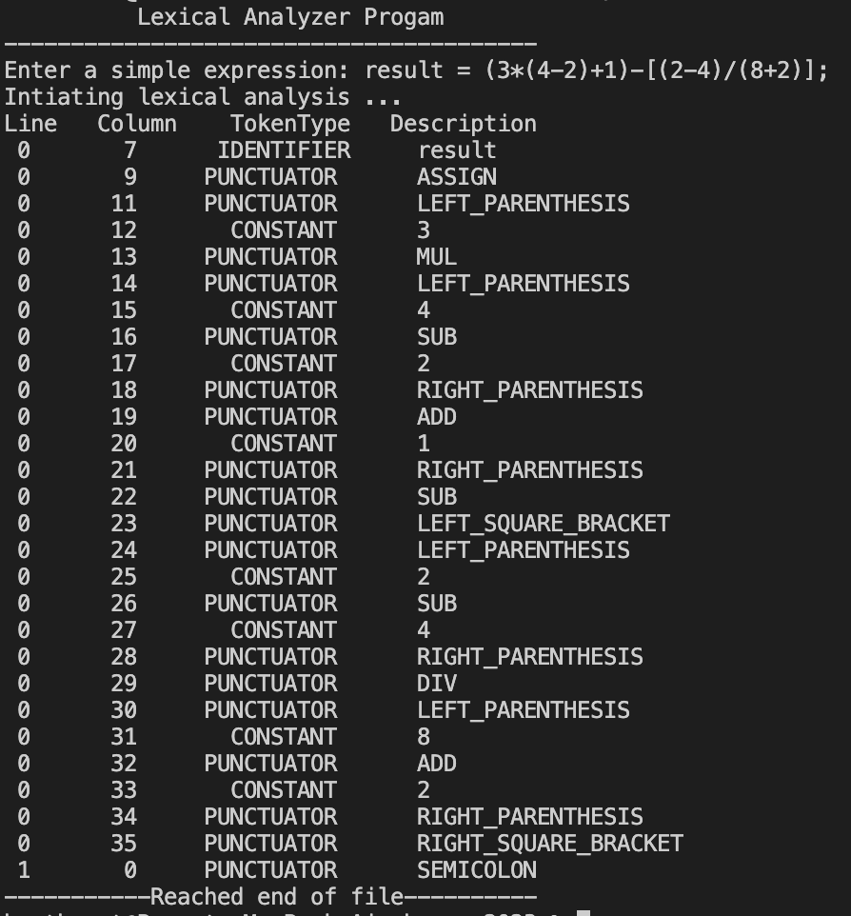
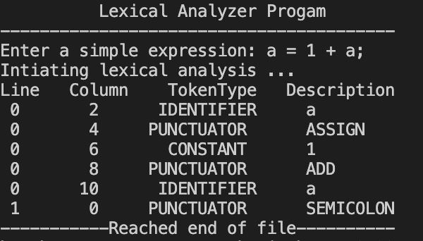
Basic Arithmetic Operations samples

Slide 18
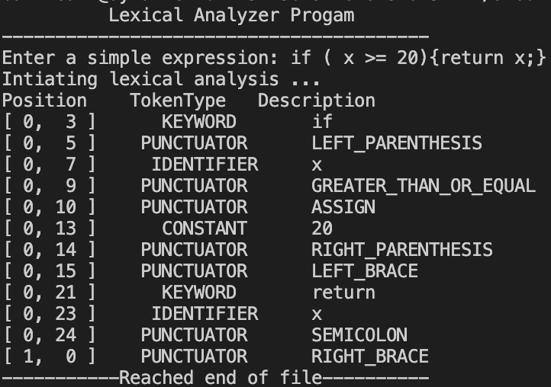
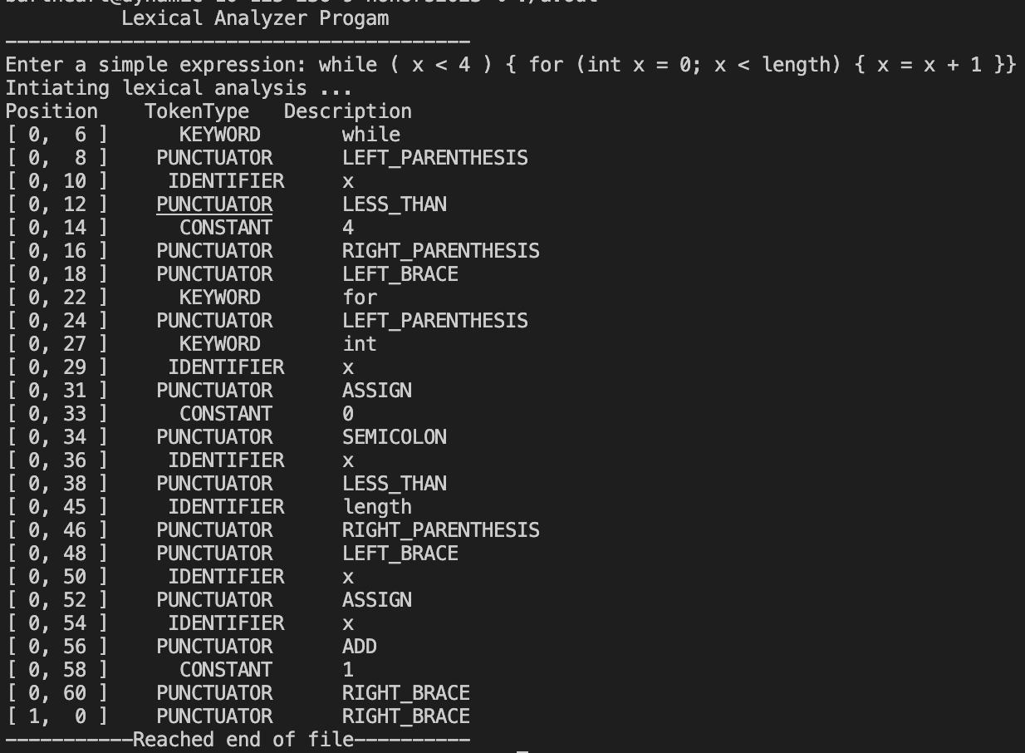
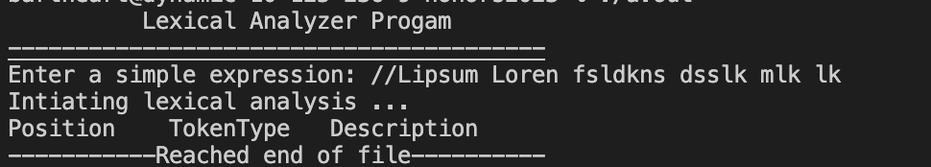
Basic Arithmetic Operations samples
Loops and conditions
Conditional Statements
Comment Prompt ( ‘ // ‘ )

